Slide 1
IST718 Recommendation Systems
Willard Williamson
Adjunct Professor
iSchool, Syracuse University
linkedin.com/in/ncc-1701-d

Slide 2
Use case: A recommendation system
This problem seeks to find similarities between what a user or set of users have liked in the past with new items never seen before
This problem can be casted as an unsupervised learning approach if we seek to map high dimensional data into low dimensional data
Movies

Slide 3
Use case: a recommendation system
This problem seeks to find similarities between what a user or set of users have liked in the past with new items never seen before
This problem can be cast as an unsupervised learning approach if we seek to map high dimensional data into low dimensional data
Movies
Drama
Action

Slide 4
Use case: a recommendation system
This problem seeks to find similarities between what a user or set of users have liked in the past with new items never seen before
This problem can be cast as an unsupervised learning approach if we seek to map high dimensional data into low dimensional data
Movies
Ek Phool Do Mali
Drama
Fast and furious
Action

Slide 5
Use case: a recommendation system
This problem seeks to find similarities between what a user or set of users have liked in the past with new items never seen before
This problem can be cast as an unsupervised learning approach if we seek to map high dimensional data into low dimensional data
Movies
Releveant
Ek Phool Do Mali
Drama
Non-relevant
Fast and furious
Action

Slide 6
Use case: a recommendation system
Procedure:
Movie data starts out with many columns of feature data
Perform dimensionality reduction on the many columns of data thus reducing the number of columns
Group movies by user likes
Check what movies are close to the movies a user likes based on a distance function
The circle to the right shows the distance function.
Say a user likes “Good Will Hunting”, recommend the 2 other movies in the circle.
Ek Phool Do Mali
Drama
Good will
hunting
The Pianist
Action

Slide 7
Dimensionality reduction: why?
Performing nearest neighbor search in high dimensions is really hard.
Basically, the distance between close and far points becomes smaller and smaller as the number of dimensions increases!
See Beyer K., Goldstein J., Ramakrishnan R., Shaft U. (1999) When Is “Nearest Neighbor” Meaningful?
Example:
A unit ball from -1 to 1 in n dimensions
What happens to the volume of a ball as the number of dimensions increases?
https://en.wikipedia.org/wiki/Volume_of_an_n-ball

Slide 8
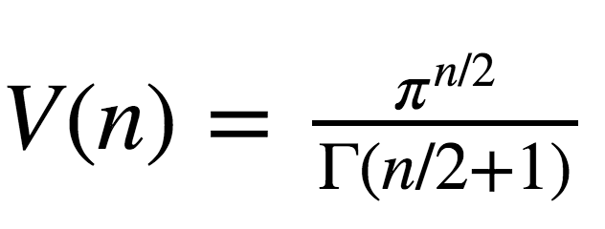
Unit Ball Volume vs. Num Dimensions
Notes:
https://en.wikipedia.org/wiki/Volume_of_an_n-ball

Slide 9
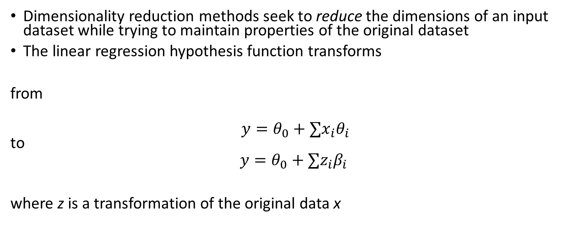
Dimensionality reduction
Dimensionality reduction methods seek to reduce the dimensions of an input dataset while trying to maintain properties of the original dataset
The linear regression hypothesis function transforms
from
$$y=θ_{0}+∑x_{i}θ_{i}$$ to
$$y=θ_{0}+∑z_{i}β_{i}$$
where z is a transformation of the original data x

Slide 10
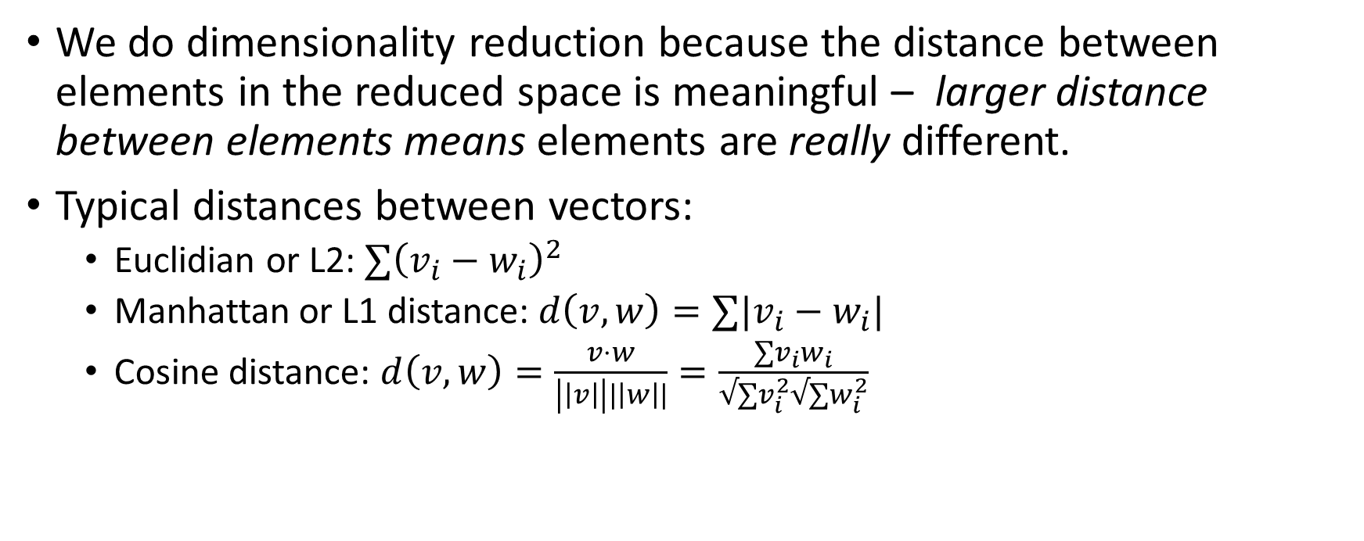
Dimensionality reduction
We do dimensionality reduction because the distance between elements in the reduced space is meaningful – larger distance between elements means elements are really different.
Typical distances between vectors:
Euclidian or L2: $∑{\left(v_{i}−w_{i}\right)}^{2}$
Manhattan or L1 distance: $d\left(v,w\right)=∑|v_{i}−w_{i}|$
Cosine distance: $d\left(v,w\right)=\frac{v⋅w}{\left|\left|v\right|\right||\left|w\right||}=\frac{∑v_{i}w_{i}}{√∑v_{i}^{2}√∑w_{i}^{2}}$

Slide 11
Principal Component Analysis
Produces a low dimensionality representation of the original data
Use PCA “scores” to represent lower dimensions of the original high dimension data
Use the PCA “loadings” to gain insight about the lower dimensionality representation (inference) using tools such as the biplot
Each principal component loading vector captures a fraction of the dataset variance.
The highest variance typically offers the highest predictive value

Slide 12
Why is variance important in data science?
Horsepower | Num Cylinders | Weight | Miles Per Gallon
300 | 8 | 3500 | 19
450 | 8 | 4200 | 12
250 | 8 | 3100 | 22
275 | 8 | 3100 | 23
320 | 8 | 3500 | 18
In the made up dataset above, we try to predict miles per gallon based on weight, number of cylinders, and horsepower.
The number of cylinders has 0 variance so it offers no predictive value to the miles per gallon.
Horsepower and weight both have variance and can be used to predict miles per gallon.

Slide 13

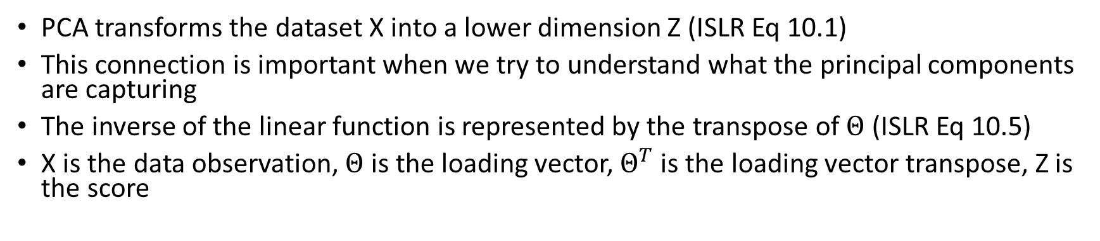
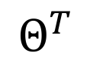
PCA Transform and Inverse Transform
PCA transforms the dataset X into a lower dimension Z (ISLR Eq 10.1)
This connection is important when we try to understand what the principal components are capturing
The inverse of the linear function is represented by the transpose of $Θ$ (ISLR Eq 10.5)
X is the data observation, $Θ$ is the loading vector, $Θ^{T}$is the loading vector transpose, Z is the score
$$Θ$$
x
z
$$Θ^{T}$$

Slide 14
Apply PCA transform and inverse transform to MNIST digit dataset

Slide 15
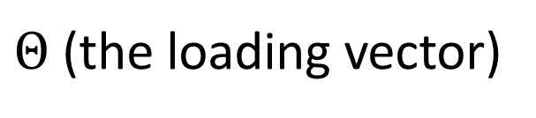
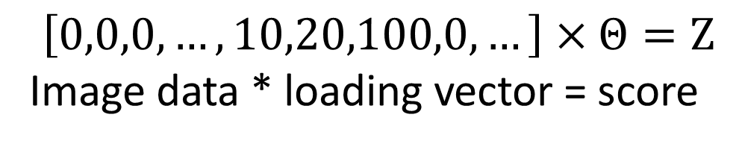
Example: MNIST digit dataset
$Θ$ (the loading vector)
X = 64-dim vector
(a row in the data set)
The score
PC 1 (loading vector
direction)
$$\left[0,0,0,…,10,20,100,0,…\right]×Θ=Z$$
Image data * loading vector = score

Slide 16

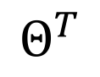
Example: MNIST digit dataset
$$Θ$$
X = 64-dim vector
PC 1
-0.92867
X’ = 64-dim vector
PC 1
$$Θ^{T}$$

Slide 17
Example: MNIST digit dataset
$$Θ$$
X = 64-dim vector
PC 1
-0.92867
X’ = 64-dim vector
PC 1
$$Θ^{T}$$

Slide 18
Example: MNIST digit dataset
$$Θ$$
X = 64-dim vector
PC 1
8.288
X’ = 64-dim vector
PC 1
$$Θ^{T}$$

Slide 19
Example: Using 1 PC

Slide 20
Example: Using 2 PC

Slide 21
Example: Using 3 PC

Slide 22
Example: Using 4 PC

Slide 23
Example: Using 10 PC

Slide 24
Example: Using 20 PC

Slide 25
Example: Using 30 PC

Slide 26
Example: Using 40 PC

Slide 27
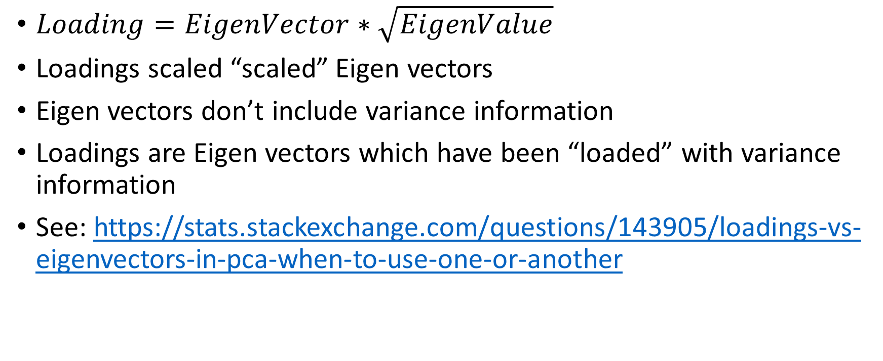
Aside: Loading Vectors vs. Eigenvectors
$Loading=EigenVector∗\sqrt{EigenValue}$
Loadings scaled “scaled” Eigen vectors
Eigen vectors don’t include variance information
Loadings are Eigen vectors which have been “loaded” with variance information
See: https://stats.stackexchange.com/questions/143905/loadings-vs-eigenvectors-in-pca-when-to-use-one-or-another

Slide 28
Recommender System Demo ipynb

Slide 29


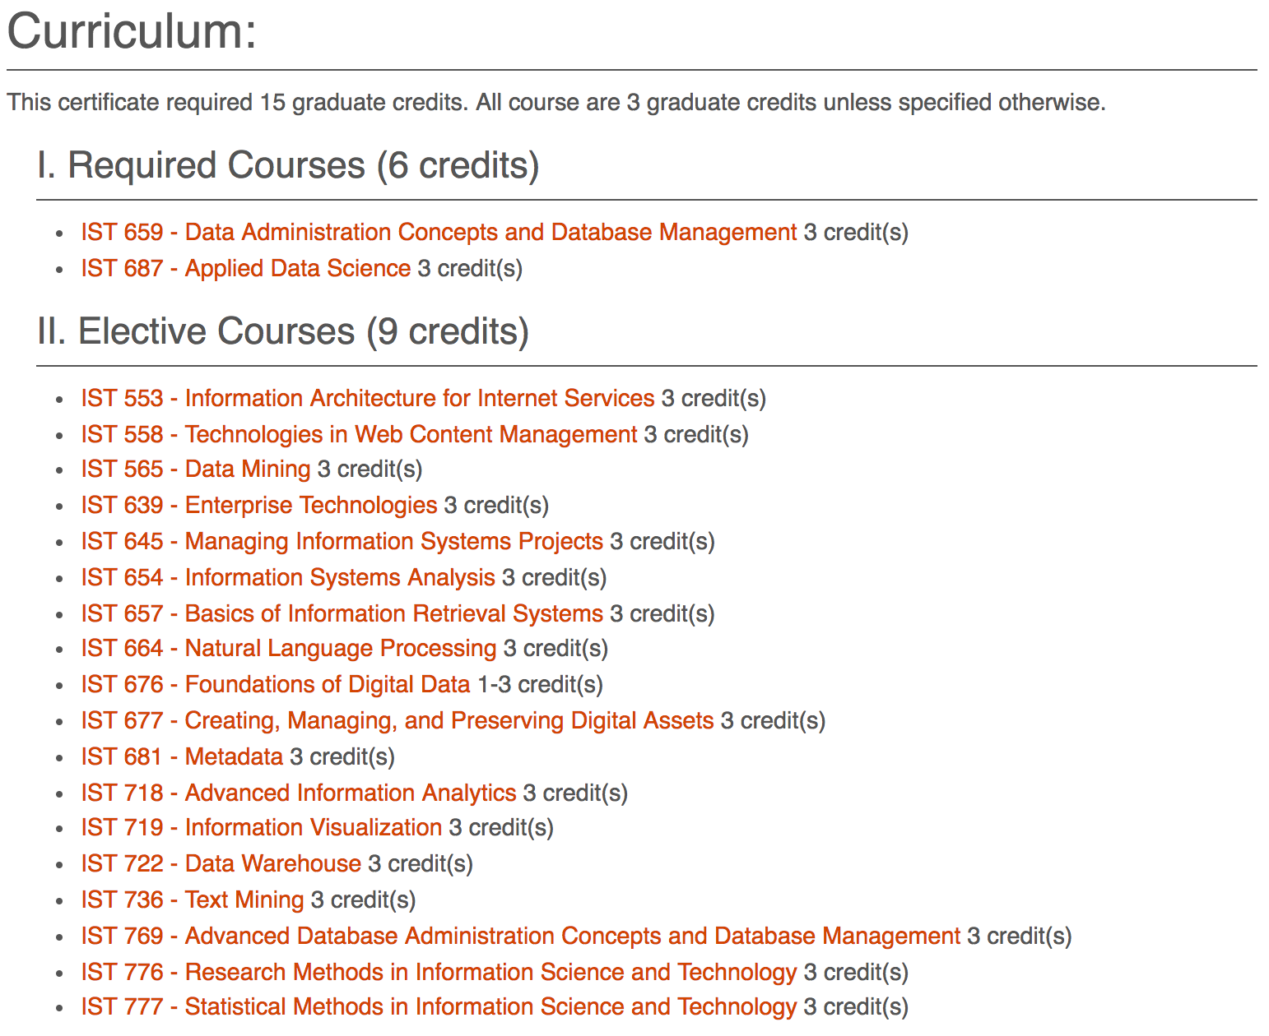
Ipynb Code Demo

Slide 30
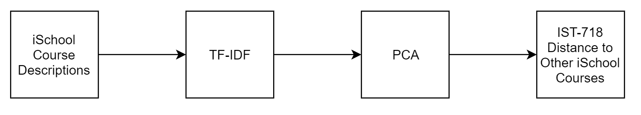
Ipynb Code DemoBlock Diagram

Slide 31
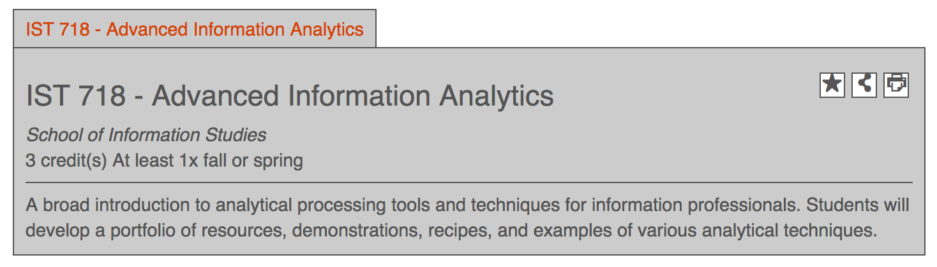
Ipynb Code Demo
Apply dimensionality reduction and suggest based on nearest neighbors in lower dimension

Slide 32
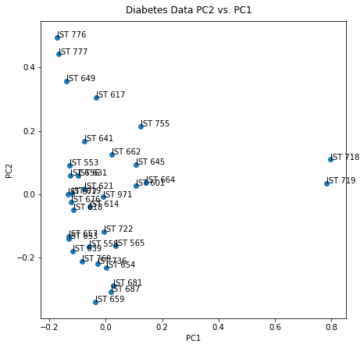
Ipynb Code Demo
Use PCA on TFIDF matrix to map courses to a low dimensional space

Slide 33
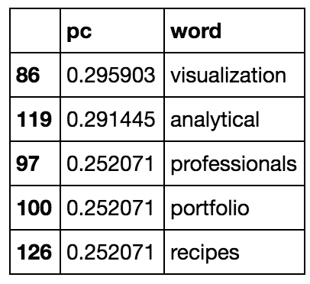
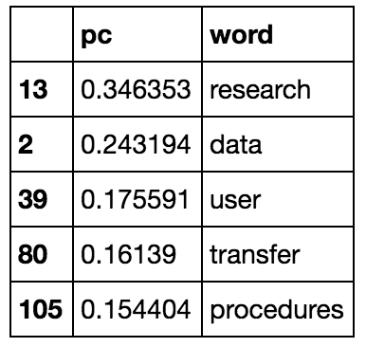
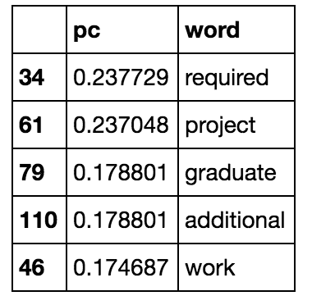
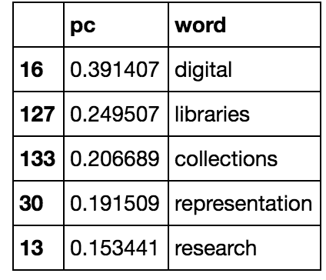
Biggest absolute loadings of PCA
Absolute value of loadings
PC 1
PC 2
PC 3
PC 4
Any interpretation?

Slide 34
Improvement Idea: Compute distance on multiple course factors
Transform course description to TF-IDF
Use PCA on TF-IDF to reduce dimensionality of the TF-IDF matrix
Compute similarity between IST-718 and other courses in the course catalog
Other features like student course reviews could possibly be added to the feature columns (only course description TF-IDF is used in the example recommendation system notebook)
description
PCA of TF-IDF
[0.1, 0.2, -0.5, …]
Other possible features

Slide 35
Improvement Idea: Compute distance on multiple course factors
The example below shows how we might define a similarity function using TF-IDF on the description, and 3 other factors: Level 1, level 2, and level 3 where the levels could represent other course characteristics like the student reviews of the course.
Description space
Level 1 space
Level 2 space
Level 3 space
IST 718
IST 718
IST 718
IST 718
IST 617
IST 617
IST 617
IST 617
$$D\left(a,b\right)=αD_{description}\left(a,b\right)+βD_{level1}\left(a,b\right)+γD_{level2}\left(a,b\right)+η D_{level3}(a,b)$$

Slide 36
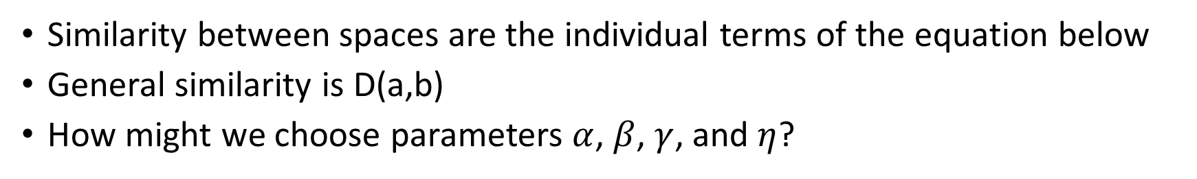
Idea: Define a similarity function between spaces and a general similarity function
Similarity between spaces are the individual terms of the equation below
General similarity is D(a,b)
How might we choose parameters $α$, $β$, $γ$, and $η$?
$$D\left(a,b\right)=αD_{description}\left(a,b\right)+βD_{level1}\left(a,b\right)+γD_{level2}\left(a,b\right)+η D_{level3}(a,b)$$

Slide 37
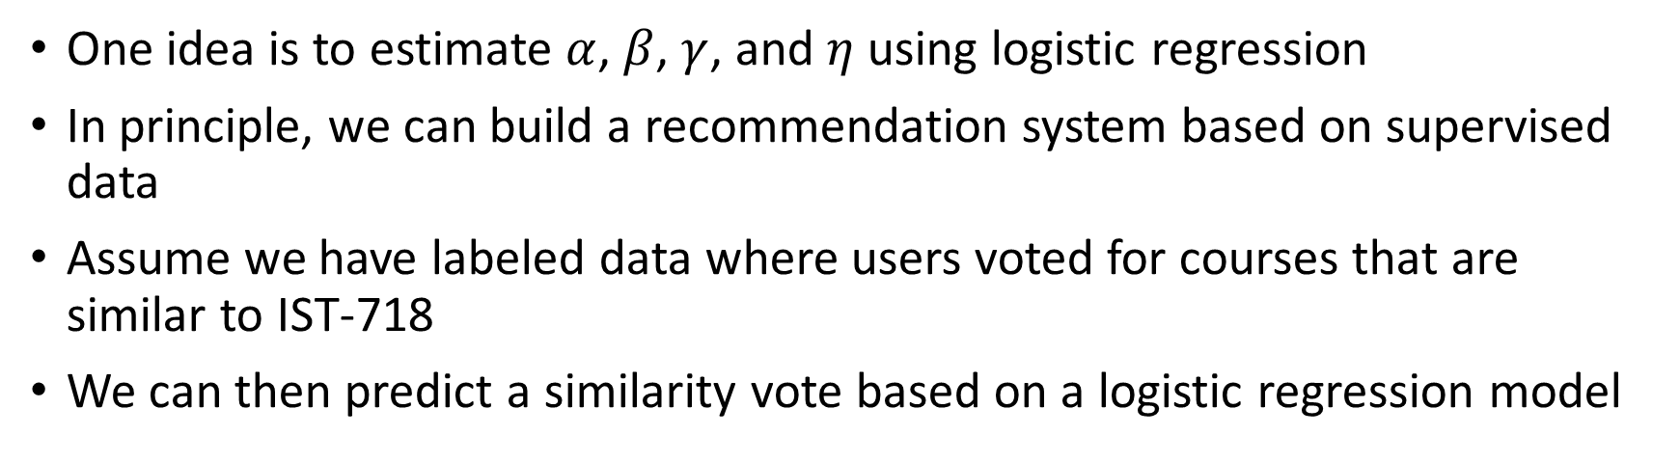
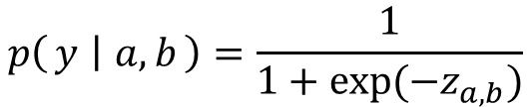
Using logistic regression to suggest courses
One idea is to estimate $α$, $β$, $γ$, and $η$ using logistic regression
In principle, we can build a recommendation system based on supervised data
Assume we have labeled data where users voted for courses that are similar to IST-718
We can then predict a similarity vote based on a logistic regression model
$$z_{a,b}=αD_{description}\left(a,b\right)+βD_{level1}\left(a,b\right)+γD_{level2}\left(a,b\right)+η D_{level3}(a,b)$$
$$p\left(y ∣ a,b\right)=\frac{1}{1+exp⁡(−z_{a,b})}$$

